Slide 1
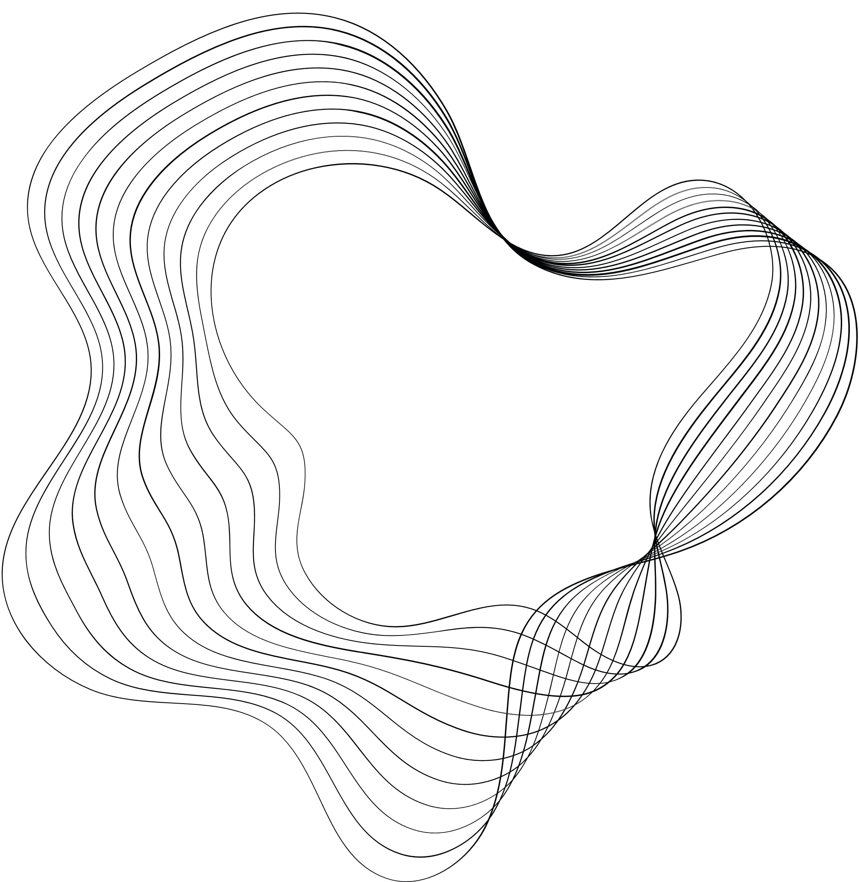

CS338. HOMEWORK 1
Presented By
22520109 – NGUYEN GIA BAO

Slide 2
CONTENTS
SUMMARY
Table of contents
Data description
Introduce dataset, visualize errors and missing values
Missing values handling
Handling missing values using basic and advanced techniques
Drop rows with missing values
Mean/Median Imputation
Advanced techniques (KNN, MICE)
Conclusion
Summarize the results

Slide 3
DATASET
In this homework, we use the “Cafe Sales - Dirty Data for Cleaning Training” data set from kaggle.
File Information
File Name: dirty_cafe_sales.csv
Number of Rows: 10,000
Number of Columns: 8

Slide 4
DATASET
Columns Descriptions:
Transaction ID: A unique identifier for each transaction. Always present and unique.
Items: The name of the item purchased. May contain missing or invalid values (e.g., "ERROR").
Quantity: The quantity of the item purchased. May contain missing or invalid values.
Price Per Unit: The price of a single unit of the item. May contain missing or invalid values.
Total Spent: The total amount spent on the transaction. Calculated as Quantity * Price Per Unit.
Payment Method: The method of payment used. May contain missing or invalid values (e.g., None, "UNKNOWN").
Location: The location where the transaction occurred. May contain missing or invalid values.
Transaction Date: The date of the transaction. May contain missing or incorrect values.

Slide 5
DATASET
Data Characteristics
Missing Values:
  Some columns (e.g., Item, Payment Method, Location) may contain missing values represented as None or empty cells.
Invalid Values:
  Some rows contain invalid entries like "ERROR" or "UNKNOWN" to simulate real-world data issues.
Price Consistency:
  Prices for menu items are consistent but may have missing or incorrect values introduced.

Slide 6
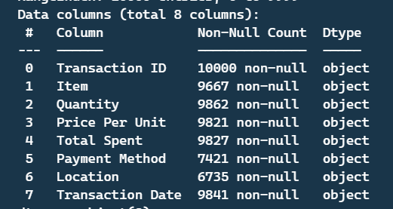
DATASET
Data description

Slide 7
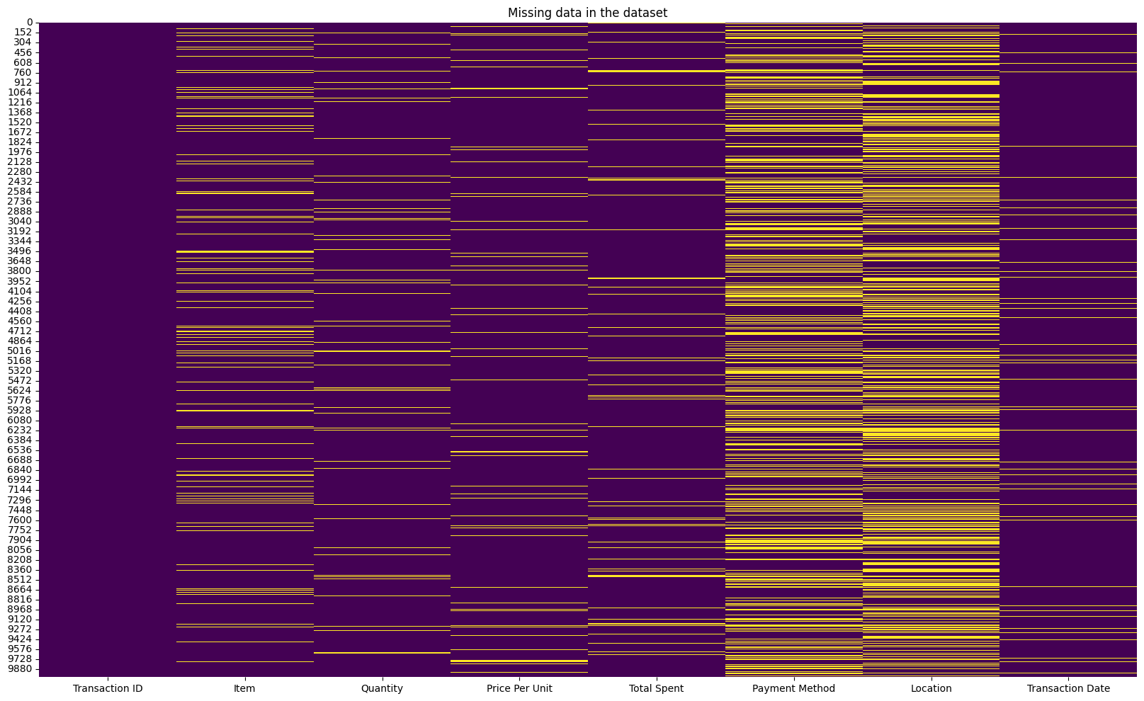
Heatmap to show how missing values scatter in the data set

Slide 8
Heatmap to show how missing values scatter in the data set
Transaction ID
Price Per Unit
Total Spent
Payment Method
Location
Transaction date
item
Quantity
  Missing values appear in every columns except Transaction ID, because this column is key.
  There’re rows that miss multiple values.
  Payment Method and Location miss a large number of values.

Slide 9
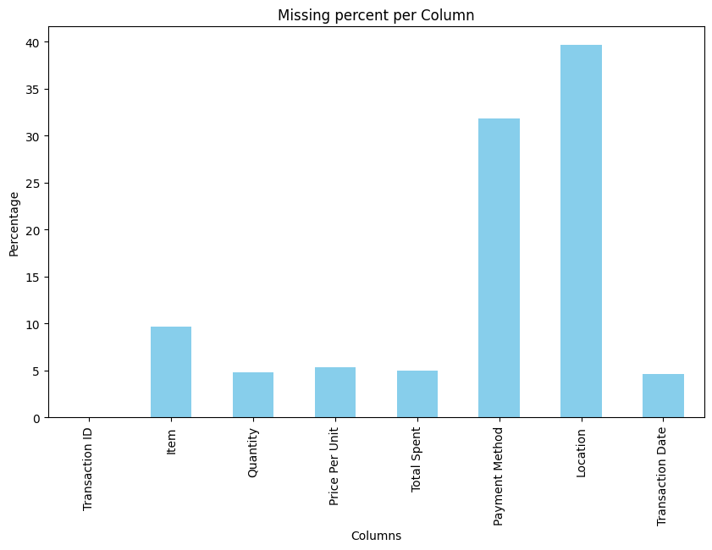
Heatmap to show how missing values scatter in the data set
  As we can see, Location and Paymen Method have more than 30% samples missed --> This will cause difficults for model to learn from this dataset.
  Transaction Date and Transaction ID have least missing points, but these two will not be used as features.
  The other columns have a moderate amount of missing data points, still allowing the application of techniques to fill them in.

Slide 10
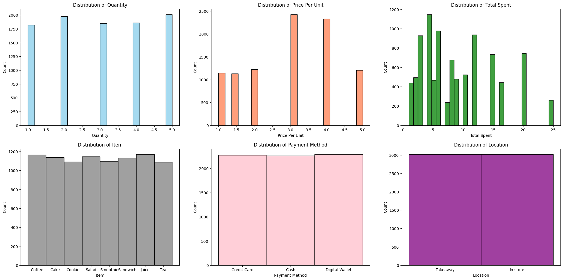
Distribution of values in each column

Slide 11
Distribution of values in each column
All columns don’t have normal distribution

Slide 12
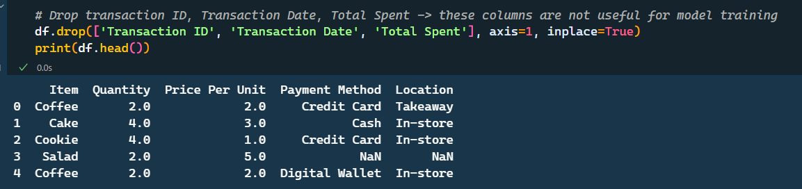
Problem choosing
Because there’s no problems associated with this datasets, we have to create one. In this homework, we’ll process data to train a model predicting Quantity values
First, we have to drop columns Transaction ID and Transaction Date because these two don’t give useful information. We drop Total Spent too, cause this column has a strong relation with Quantity and Price Per Unit, which will create data leakage.

Slide 13
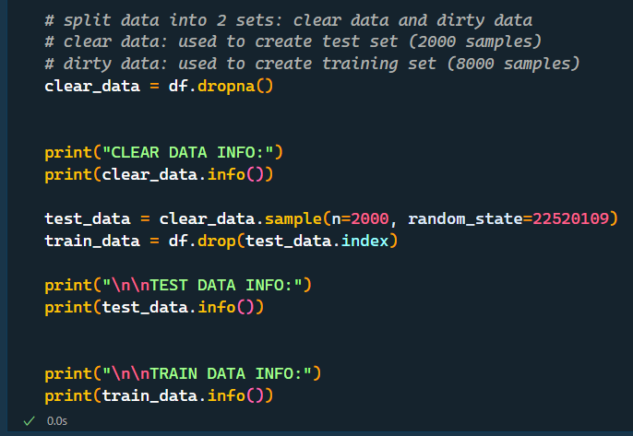
Problem choosing
After that, we split dataset into 2 sets: train and test (8:2). Test set has 2000 complete rows. Train has 8000 rows, bot missing and complete rows.

Slide 14
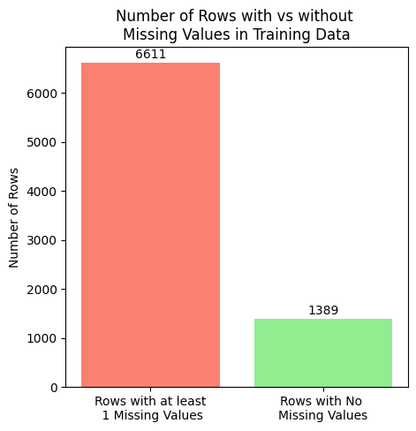
Method 1: Drop rows with missing values
In this method, we will drop any rows that contains at least 1 missing values. This will create a complete train set to for model to learn
However, this method will drop a lot of rows. There’re only 1389 rows left, while test data has 2000 rows. This will cause a huge data lost.

Slide 15
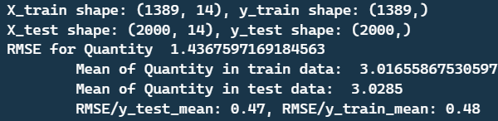
Method 1: Drop rows with missing values
Result: RMSE for the Quantity column: The RMSE/mean ratio = 0.48 indicates that the model's average error accounts for 48% of the actual data, which is a very poor result. It can be seen that after removing the Total Spent column, the correlation Total Spent = Quantity * Price Per Unit no longer exists. Additionally, the data in the Quantity column does not have a normal distribution, so the linear regression model does not perform well. Removing rows with missing data results in the train set being smaller than the test set, which also increases the error rate due to the model not having enough data to learn

Slide 16
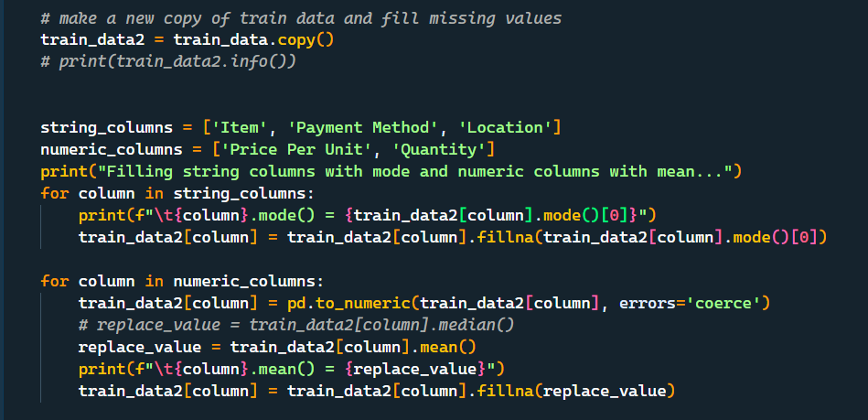
Method 2: Mean/Median Imputation
In this method, we will not drop any rows but use mean/median values to fill in missing values.
But, there’re columns that have string type values. To tackle this, we use mode to fill in values of these columns.

Slide 17
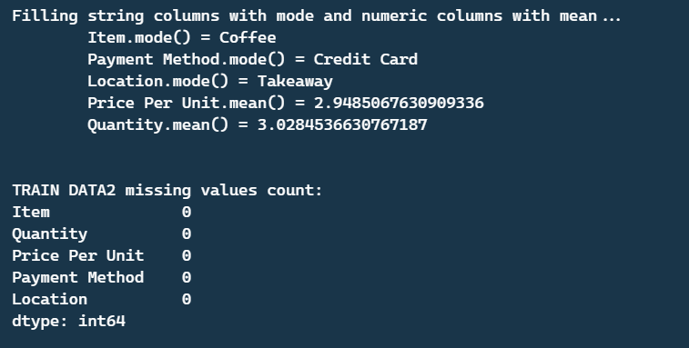
Method 2: Mean/Median Imputation
This is values we’ll fill in missing points for correspond columns
Train data after filling: No more missing value

Slide 18
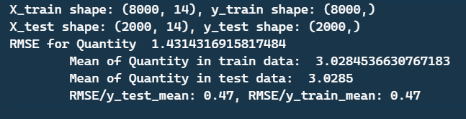
Method 2: Mean/Median Imputation
Result: In this method, the number of samples in the training set has increased, but in reality, the majority of them are values filled in using the mode/mean. These values are mostly incorrect and introduce noise into the model's learning process. Therefore, the results obtained are still not good, although there is a 1% improvement.
The same issue occurs when replacing the Mean with the Median.

Slide 19
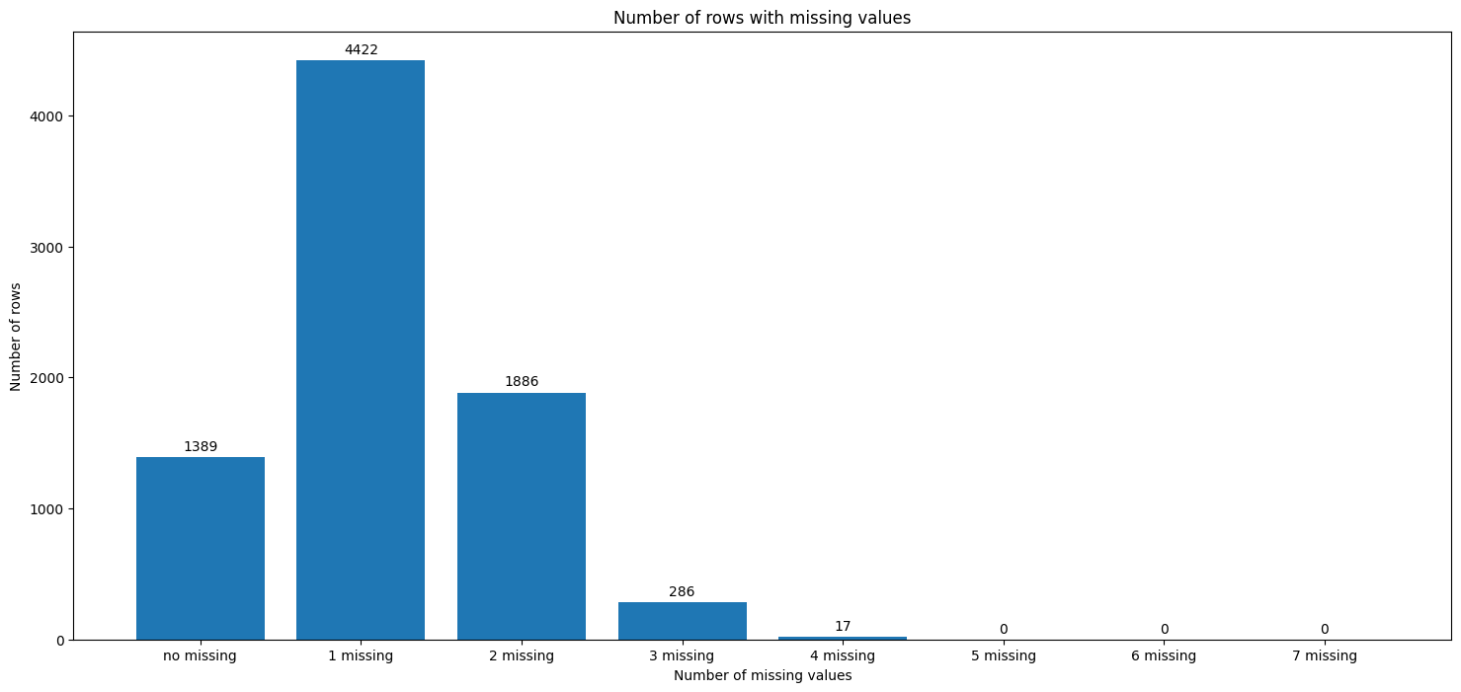
Method 3.1: Custom KNN
Main idea: Since the data has missing values in multiple columns, and the rows may have one or more missing columns, we will extract a subset from train_data containing rows with no missing values to train a KNN model. Then, we will use this trained KNN model to predict the missing values (one column at a time) in the remaining part of train_data.

Slide 20
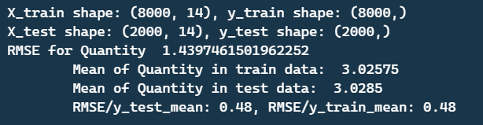
Method 3.1: Custom KNN
Result: The results show that the error rate remains unchanged compared to method 1, and is even lower than method 2. Although the KNN model was trained on a complete dataset to predict missing values in the rest of the training set, during prediction, there are samples with many missing feature values, and these missing values are filled with mode/mean, so the results do not improve much compared to previous methods.

Slide 21
Method 3.2: KNNImputer (sklearn.impute)
Use KNNImputer from sklearn.impute to fill in missing points.
Custom KNN
KNNImputer
Splits the training set into two parts: complete (no NaNs) and missing (containing only rows with at least one NaN). Uses the complete set to train the KNN, then uses the trained KNN model to predict the missing values in the missing set. The problem encountered is that rows in the missing set may have missing data in the features columns (occurs when the row is missing in more than two data fields). Solution: Temporarily fill the missing values in the features columns with Mean/Mode
Uses the original training set, no temporary filling is needed. When using the fit command, KNNImputer iterates through each row in the dataset, for each missing value in a column, it finds the k nearest rows in the space for reference, then takes the average value of those k rows and fills it into the missing field in the target row. Does not encounter the problem of missing data in the features columns because KNNImputer only performs calculations with other rows that have the same non-missing data columns as the target row. For example, the target row is missing values x1, x2 and has enough values from x3 to x8, and we need to fill in x1, then KNNImputer will search for rows with value x1, missing value x2 and having enough values from x3 to x8 to calculate the Euclidean distance in space with the target row, then select the k nearest rows, take the average value of x1 and fill in the missing x1 of the target row.

Slide 22
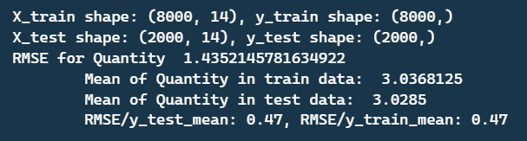
Method 3.2: KNNImputer (sklearn.impute)
Use KNNImputer from sklearn.impute to fill in missing points.
Result
The model's results remain largely unchanged. The way KNN works ignores rows with a number of missing features different from the target column, so the number of valid neighbors that the algorithm finds in this dataset is not large, which is why the results are not improved.

Slide 23
Method 3.3: MICE
MICE treats each column with missing values as a dependent variable and uses the other columns as features to predict the missing values through a regression model (usually linear regression).
The process is performed sequentially (chained) through each column and repeated multiple times to improve the results.

Slide 24
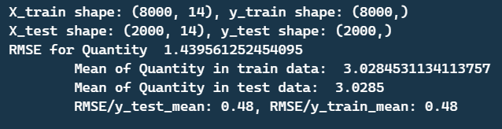
Method 3.3: MICE
Result
The model's error rate does not decrease; it even increases by 1% compared to KNNImputer. This demonstrates the impact of the amount of lost data. Regardless of whether complex or simple missing data resolution methods are implemented, the results do not show any difference.

Slide 25
Summary results
 | RMSE | RMSE/mean
Dropping rows with missing values | 1.436 | 0.48
Mean/Median Imputation | 1.431 | 0.47
Custom KNN | 1.439 | 0.48
KNNImputer | 1.435 | 0.47
MICE | 1.439 | 0.48

Slide 26
Conclusion
  Among the missing data handling methods used, Custom KNN and MICE yielded the best results, though not significantly different from other methods. The primary reason is that this dataset lacks information not only in one column but also has missing data scattered across all columns (except for the Transaction ID column, which does not provide information for the machine learning model). The Location and Payment Method columns have too much missing data, making the learned information negligible, and the model's performance low. After removing the constraints between the numerical data columns, the model's learning ability significantly decreased.
  The Dropping rows with missing values method caused particularly large information loss for this dataset (losing approximately 6000/10000 samples, more than half of the samples). However, the overall results of this method are not significantly different, because the missing data is too large, concentrated in columns with no clear relationships, so even when reused with advanced methods, it cannot provide value and may even introduce noise.
  The loss of data has significantly affected the quality of information that the dataset provides.

Slide 27
The End

